Slide 1
Data Analysis
Portfolio
Prepared By:- Savnesh Daksh

Slide 2
Professional Background
I am Savnesh Daksh I have completed Bachelor of Computer Application in 2018-21 from Mahatma Jyotiba Phule Rohilkhand University, Bareilly (UP) with a CGPA of 6.8 and I am recently Master of Computer Application pass out from Chandigarh University, Mohali (Punjab) with a CGPA of 6.5.
I have completed Data Science and Artificial Intelligence 6 months of training online program from Onetruweb software solution private limited, Bangalore (Karnataka)
I have completed 4 months Data Analyst Trainee from Trainity, Jaipur (Rajasthan) and 1 months of Data Analyst Internship from MeriSKILL, Noida (UP)
I have developed a strong foundation in applying analytical techniques and utilizing data-driven insights to solve complex problems. I have successfully contributed to various stages of the data science lifecycle, from data acquisition and cleaning to model development, evaluation, and deployment.
During my tenure, I have gained expertise in extracting, transforming, and loading (ETL) large datasets from diverse sources.
I have utilized Python and SQL extensively to manipulate and analyze data, employing statistical methods and machine learning algorithms to uncover patterns and make accurate predictions. Additionally, I have experience in data visualization, presenting findings and actionable recommendations to stakeholders in a clear and concise manner.
I am a highly motivated and results-oriented individual with a strong passion for Data Science and Artificial Intelligence. I am proficient in Python, R, MySQL, Artificial Intelligence, Machine Learning, Deep Learning, MS Excel, MS Power BI, MS Power Query, Computer Vision I am also familiar other tools and techniques.

Slide 3
Table of Contents
Professional Background -----------------------------------------------------------------------------------------------2
Table of Contents ------------------------------------------------------------------------------------------------------- 3-5
1. Data Analytics Process in everyday life / Data Analysis---------------------------------------------------------6-9
Found the best online certification program using data analytics and explaining it with six steps data analytics process
i.e. plan, prepare, process, analyze, share and act
Instagram User Analytics / SQL, MySQL workbench----------------------------------------------------------10-19
Find business insights that can be used by teams across the business to launch a new marketing campaign, decide on features to build for the app
measuring user engagement and improving the experience altogether while helping the business grow
3. Operation Metrics and Analytics / SQL, MySQL workbench------------------------------------------------20-29
Used Advanced SQL skills to analyze the data to answer questions posed by different departments within the company
Provided valuable insights that can help in improving the company's operations and understand sudden changes in key metrics

Slide 4
4. Hiring Process Analytics / Microsoft Excel-------------------------------------------------------------------------30-38
Analyzed previous hiring dataset of an MNC to observe trends and drawing insights out of it useful for hiring department
Helped the company to improve its hiring process and make better hiring decisions in the future.
5. IMDB Movie Analysis / Microsoft Excel-------------------------------------------------------------------------------39-50
Generated meaningful insights from the IMDB dataset to plan every move analytically based on data
Helped the company to make movie that appeals to both Indian and global audience while minimizing the risk of losses
6. Bank Loan Case Study / Python, Matplotlib, Seaborn-------------------------------------------------------------51-66
Used EDA to understand how customer attributes & loan attributes influence the likelihood of default
This information helped the bank to make decisions such as denying the loan, reducing loan amount etc.
7. Impact of Car Features / Python, Tableau-----------------------------------------------------------------------------67-75
Gained insights and provided recommendations for price optimization & product development decisions to maximize profitability
Used regression analysis to identify the variables that have the strongest relationship with a car's price
Created an Interactive Dashboard

Slide 5
8. ABC Call Volume Trend Analysis / Python, Tableau--------------------------------------------------------76-86
Analyzed inbound calling team data of a company, to extract useful insights
provided recommendations for manpower planning to reduce call abandon rate from 30% to 10% and improve customer experience.
9. Appendix: GitHub links for all projects------------------------------------------------------------------------87
10. Linkedin and GitHubProfile Link-----------------------------------------------------------------------------88

Slide 6
Data Analytics Process in everyday life
Objective
Let's extend the concept of using data analytics in everyday life to the.
context of planning a long project involving airport travel and flight booking.

Slide 7
Proceeding with data analytics process
Plan
• Destination Selection : - For a long trip, you may decide on a specific destination,
considering factors like personal interests, weather, cultural events, and
attractions. Data analytics tools can help you gather and analyze information
about various destinations to make an informed choice.
Prepare
• Budgeting :- Determine your travel budget, considering not only flight and
accommodation costs but also daily expenses during your trip. Data analytics
can assist in setting a realistic budget by providing insights into average costs
at your destination.

Slide 8
Process
• Flight Booking:- Use flight booking websites and apps that leverage data
analytics to find the best flight options based on your budget, preferred
airlines, and travel dates. These platforms often use algorithms to optimize pricing.
Analyze
• Accommodation Selection:- Analyze reviews and ratings from previous guests
to choose the best accommodation. Data analytics can help you identify trends
and patterns in reviews to make an informed decision.
Share
• Itinerary Planning:- Collaborate with travel companions by sharing digital
itineraries that include flight details, accommodation reservations, and
planned activities. Tools like shared calendars can help keep everyone on the
same page.

Slide 9
Act
• During the Trip: Utilize travel apps that provide real-time data on flight status,
gate changes, and delays. These apps can help you adapt your plans if there
are unexpected changes.
Post-Trip Analysis
• Expense Tracking: Use expense tracking apps or spreadsheets to record and
analyze your actual expenses during the trip. This data can help you assess if
you stayed within your budget.
• By incorporating data analytics at various stages of planning and executing
your long project, such as a vacation involving airport travel and flights, you
can optimize your travel experience. Data-driven decisions can help you find
the best flight deals, make informed choices about accommodation, and
ensure that your trip aligns with your budget and preferences.

Slide 10
2. Instagram User Analytics
Project Description
The Instagram User Analytics project aims to analyze a
simulated Instagram dataset using SQL fundamentals. The dataset comprises user
profiles, posts, likes, and comments. By employing SQL queries, the project seeks to
extract meaningful insights into user behavior, engagement patterns, and content
popularity on the platform.

Slide 11
Approach
Database creation:- Created and inserted the values in the database using the DDL &
DML SQL queries provided by the product manager (as per project) in the MySQL
database using MySQL workbench.
Tech-Stack Used
Used MySQL Community Server — GPL Version 8.0.32 and Connector
Version 8.0.32 for creating my project as MySQL Community Server —
GPL is a free and open-source relational database management system
that uses SQL

Slide 12
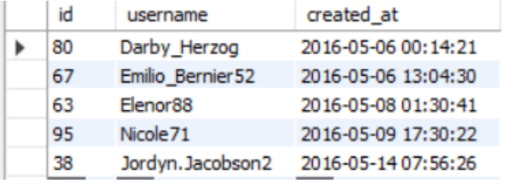
Insights : Marketing
1. Rewarding Most Loyal Users: People who have
been using the platform for the longest time.
The 5 oldest users of the Instagram from the database are
SELECT id,
username,
created_at FROM
users ORDER BY
created_at LIMIT 5;

Slide 13
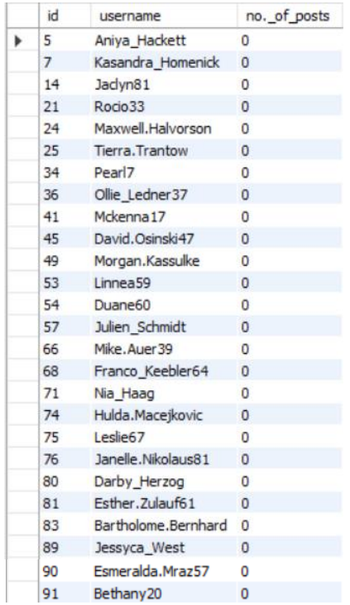
The users who have never posted a single photo on Instagram
Insights
2.Remind Inactive Users to Start Posting: By sending
them promotional emails to post their 1st photo.
SELECT u.id,
u.username,
Count(p.user_id) AS 'no._of_posts'
FROM users u
LEFT JOIN photos p
ON u.id = p.user_id
GROUP BY u.id
HAVING Count(p.user_id) = 0;

Slide 14
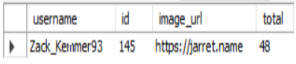
Insights
3. Contest Winner Declaration: Determine the winner of the
contest and provide their details to the team.
select username,
photos.id,
photos.image_url,
count(*) as total from photos inner join
likes on likes.photo_id = photos.id inner join
users on photos.user_id = users.id group by
photos.id order by total DESC limit 1;

Slide 15
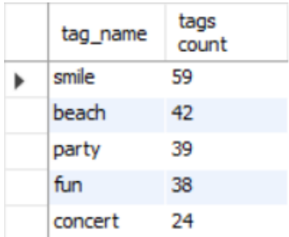
Insights
4. Hashtag Researching: A partner brand wants to know,
which hashtags to use in the post to reach the most
people on the platform.
SELECT t.tag_name,
Count(t.tag_name) AS "tags count"
FROM tags t
INNER JOIN photo_tags ph
ON t.id = ph.tag_id
GROUP BY t.tag_name
ORDER BY Count(t.tag_name) DESC
LIMIT 5;
The top 5 most commonly used hashtags on the platform are

Slide 16
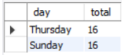
Insights
5. Ad Campaign Launch: Determine the day of the week when
most users register on Instagram.
Provide insights on when to schedule an ad campaign.
select dayname(created_at)
as day,count(*) as total from
users group by day order by total DESC limit 2;

Slide 17
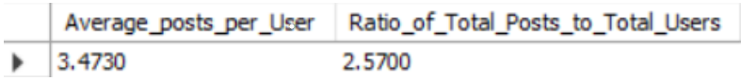
Insights : investor metrics
1.User Engagement: Are users still as active and post on Instagram
or they are making fewer posts
SELECT (SELECT Count(id)
FROM photos) /
(SELECT Count(DISTINCT user_id)
FROM photos) AS Average_posts_per_User,
(SELECT Count(id)
FROM photos) / (SELECT Count(id)
FROM users)
AS Ratio_of_Total_Posts_to_Total_Users;
Average user posts and ratio of total posts to total users in Instagram are :

Slide 18
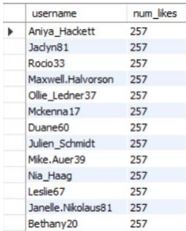
Insights
2. Bots & Fake Accounts: Identify users (potential bots)
who have liked every single photo on the site, as this is
not typically possible for a normal user.
These are some user who can be boat and fake account.
select username,
count(*) as num_likes
from users inner join
likes on users.id =
likes.user_id group by
likes.user_id having
num_likes = (select count(*) from photos);

Slide 19
Results
Learnt fundamentals of data analysis using SQL queries to extract insights from database by which we track how
users engage and interact with our digital product (software or mobile application) in
an attempt to derive business
insights for marketing, product & development teams.
❑ Conclusions from above analysis :
➢ Marketing team can reward the most loyal customers, send promotional emails to
inactive users, use popular hashtags and most active day for brand promotions.
➢ User engagement can be very useful growth success metric for the company
➢ Company can remove the bots and fake accounts from the platform to enhance the usere xperience

Slide 20
3. Operation and Metrics Analytics
Project Description
In today's data-driven world, businesses need to analyze their
operations and metrics to stay competitive. This project aims to provide insights into
two different scenarios of operation and metric analytics. One of the primary goals of
the project is to provide a dashboard that displays key performance indicators (KPIs).
The dashboard will provide a real-time view of KPIs to help managers make data
driven decisions. Both case studies will provide valuable insights into
two different scenarios and will enable businesses to make data-driven decisions,
improve operational efficiency, and enhance customer satisfaction.

Slide 21
Approach
First, the data prepared and analyzed using SQL. Various SQL functions like SELECT, WHERE,
GROUP BY, JOIN, etc. are used to extract meaningful information from the dataset.
Once the data is cleaned and transformed, the next step is to identify Key Performance
Indicators (KPIs) that are relevant to the business. These KPIs include throughput, user
engagement, user retention etc.
The final step is to create interactive charts and dashboards using Tableau. Tableau helps to
create interactive visualizations that help in identifying trends and patterns.
Tech-Stack Used
SQL Prepare
Process
Analyze data

Slide 22
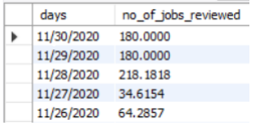
Insights : Job Data
Jobs Reviewed Over Time: Write an SQL query to calculate the number of jobs
reviewed per hour for each day in November 2020.
SELECT DISTINCT ds AS days,
Count(job_id) / (Sum(time_spent) / 3600) AS no_of_jobs_reviewed
FROM job_data
GROUP BY days;

Slide 23
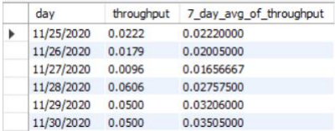
Throughput Analysis: Write an SQL query to calculate the 7-day rolling average of throughput. Additionally, explain whether you prefer using the daily metric or the 7- day rolling average for throughput, and why
SELECT a.ds AS day, a.throughput, avg(a.throughput) OVER ( ORDER BY ds rows BETWEEN 6 PRECEDING AND CURRENT row ) AS
7_day_avg_of_throughput
FROM ( SELECT ds, count(job_id) / sum(time_spent) AS throughput FROM job_data
GROUP BY ds ) AS a GROUP BY ds;

Slide 24
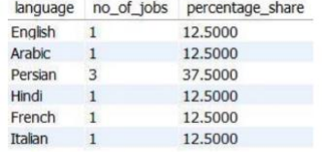
Language Share Analysis: Write an SQL query to calculate the percentage share of each language over the last 30 days.
SELECT language,
count(job_id) as no_of_jobs,
count(job_id)*100 / sum(count(*)) OVER() as percentage_share
FROM job_data
WHERE ds between '2020-11-01' and '2020-11-30'
GROUP by language;

Slide 25
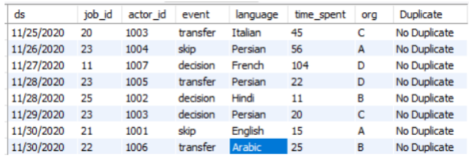
Duplicate Rows Detection: Write an SQL query to display duplicate row from the job_data table.
SELECT a.ds,
a.job_id,
a.actor_id,
a.event,
a.language,
a.time_spent,
a.org,
CASE when a.duplicates = 1 then "No Duplicate" else "Duplicate"
end as Duplicate FROM
( SELECT *, row_number() OVER (partition by ds, job_id,
actor_id, event, language, time_spent, org)
as duplicates FROM job_data ) as a ;

Slide 26
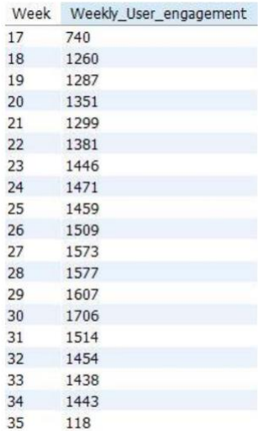
Insights: Investigating metric spike
Weekly User Engagement: Write an SQL query to calculate the
weekly user engagement.
SELECT week(occurred_at) as Week,
count(DISTINCT user_id)as Weekly_User_engagement
FROM events
GROUP BY week(occurred_at)
ORDER BY week(occurred_at);

Slide 27
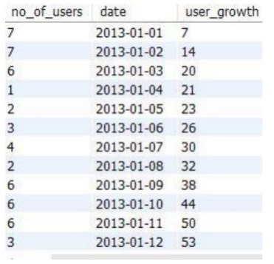
Insights
User Growth Analysis: Write an SQL query to calculate the user growth for the product
SET @g := 0;
SELECT a.no_of_users, a.date,
( @g := @g + a.no_of_users ) as user_growth
FROM
( SELECT count(user_id) as no_of_users,
date(created_at) as date
FROM users WHERE state = "active"
GROUP BY date(created_at) ) a;

Slide 28
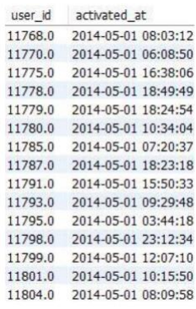
Insights
Weekly Retention Analysis: Write an SQL query to calculate the weekly retention of users based on their sign-up cohort.
SELECT user_id,
activated_at
FROM users
WHERE activated_at > '2014-05-01'
ORDER BY user_id;

Slide 29
Results
In this project, I learned how to apply advanced SQL concepts like Windows Functions, etc. I understood how the
real-world industry works. It helped me in mastering my SQL concepts. I learned how to ask the right questions given
the circumstances. From the given data and questions, which columns to consider and how to find the valuable
insights which help the business to grow. I learned how the company find different areas related to the company to
improve it further. I got to know about investigating metric spike (why there is a boom and why there is a dip).

Slide 30

4. Hiring Process Analytics
Hiring process is the fundamental and the most important function of a company.
Hiring Process Analytics involves the collection, analysis, and interpretation of data related to an organization's recruitment process.
The goal of this analysis is to improve the effectiveness and efficiency of the hiring process by identifying areas of improvement and evaluating the success of various recruitment strategies.
This can involve tracking metrics such as applicant-to-hire ratios, and candidate quality.
By using data to inform recruitment decisions, organizations can make more informed hiring decisions.

Slide 31
Approach A. Download all Data provided B. Understanding the data C. Checking for outliers D. Removing outliers E. Drawing Data Summary

Slide 32



Tech-Stack Used
I have used MS Excel to perform statistical analysis on this dataset because allows users to edit, organize, and analyze different types of information. It allows collaborations, and multiple users can edit and format files in real-time, and any changes made to the spreadsheet can be tracked by a revision history.
Google Drive
Power Point Presentation
MS Excel

Slide 33
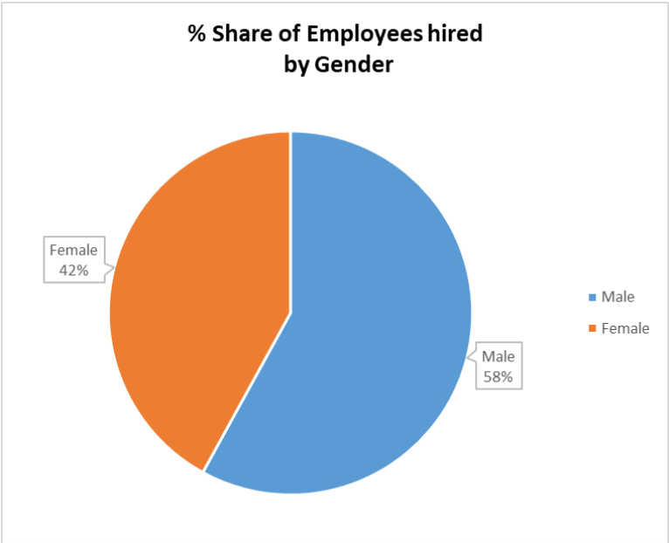
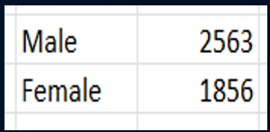
Insights
All the questions asked can be answered through Excel. I used various functions available on Excel to get the solutions.
1. Determine the gender distribution of hires. How many males and females have been hired by the company?

Slide 34
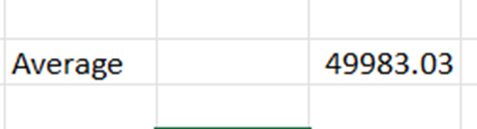
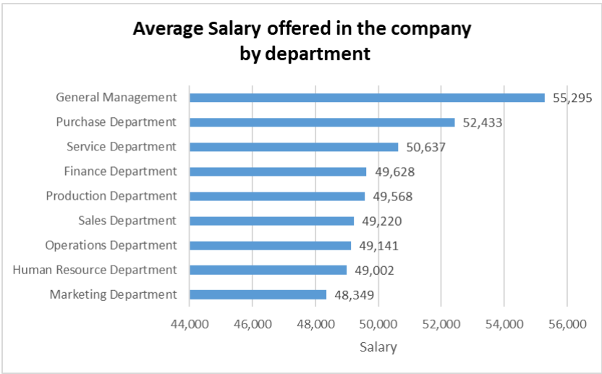
Insights
2. What is the average salary offered by this company? Use Excel functions to calculate this.

Slide 35
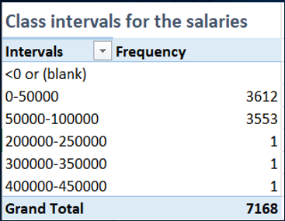
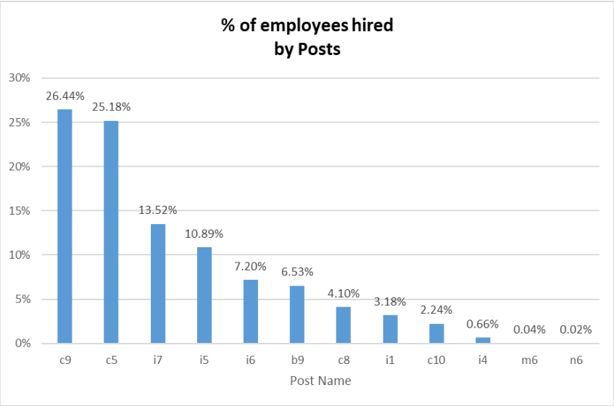
Insights
3. Create class intervals for the salaries in the company. This will help you understand the salary distribution.

Slide 36
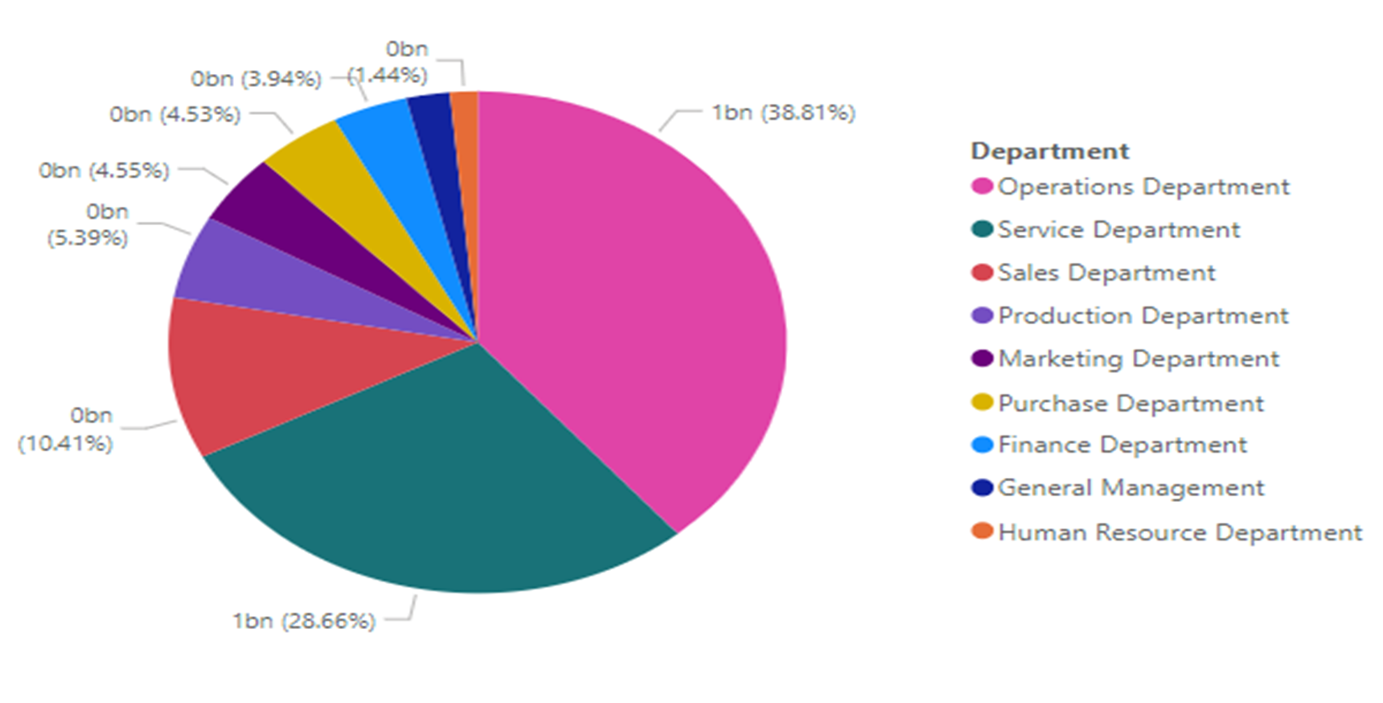
Insights
4. Use a pie chart, bar graph, or any other suitable visualization to show the proportion of people working in different departments.

Slide 37
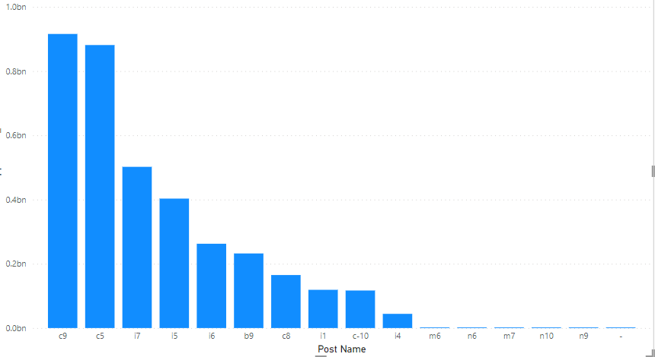
Insights
5. Use a chart or graph to represent the different position
tiers within the company. This will help you understand
the distribution of positions across different tiers.

Slide 38
Results
❑ Conclusions from above analysis :
Females(42%) are hired less as compared to the Males(58%) in the company.
Average salary offered in the company is 50k.
General management department has given the highest avg. salary(55,000) along with
very low hiring in this department.
Only 3 employees have got salary above 1lac.
Highest hiring is done for the c9 post

Slide 39




5. IMDB Movie Analysis
Project Description

Slide 40



Slide 41


TECH-STACK USED
I have used MS Excel and Python to perform statistical analysis on this dataset because allows users to edit,
organize, and analyze different types of information.
It allows collaborations, and multiple users can edit and format files in real-time, and any changes made to the spreadsheet can be tracked by a revision history.

Slide 42
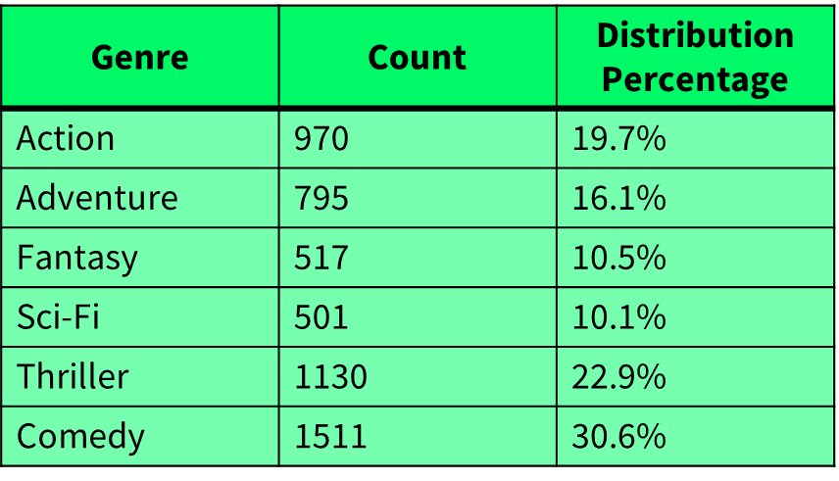
Insights
I have gained knowledge of various Excel sheet functions which helped me to solve the questions asked in this project.
Following are the functions I used: COUNT. SUBTOTAL. MODULUS. POWER. CEILING. FLOOR. And I used pivot table to create charts.
Movie Genre Analysis: Analyze the distribution of movie genres and their impact on the IMDB score.

Slide 43
Genres impact on the IMDB score
Here are the Top Genres with maximum IMDb Score
Crime | Drama has the maximum IMDb Score among all other genres
Action | Crime | Drama | Thriller Scored 2nd in the list

Slide 44
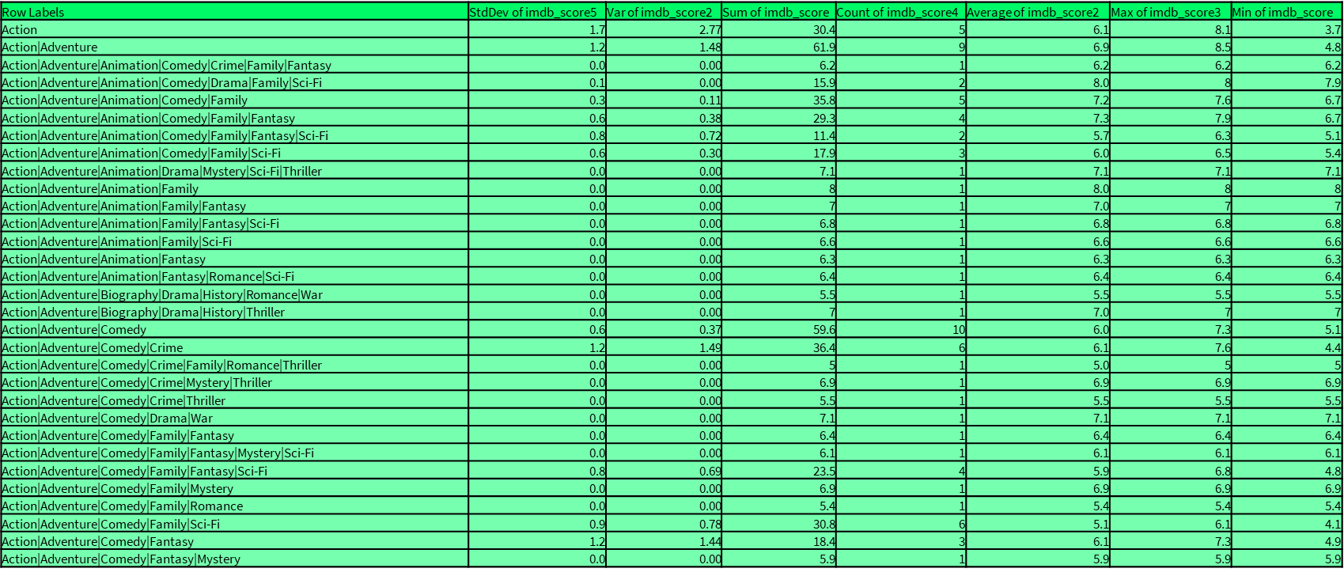
Descriptive statistics

Slide 45
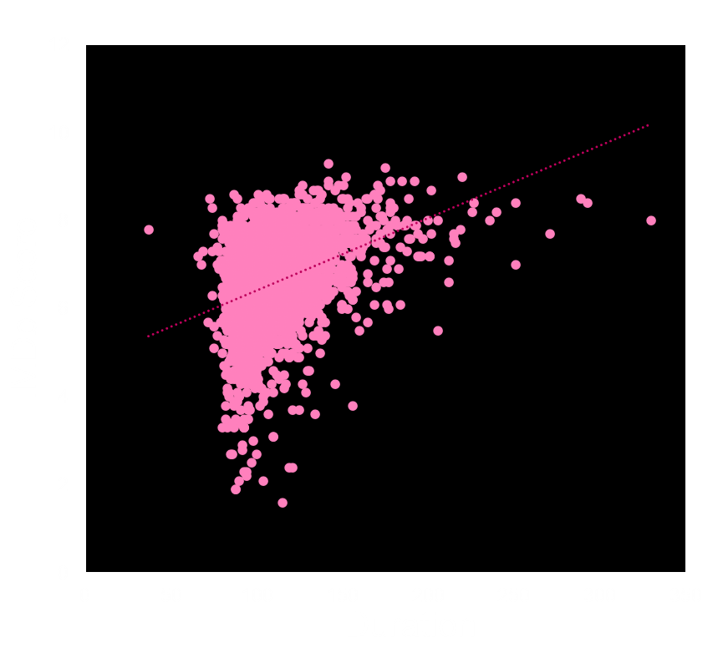
B: Analyze the distribution of movie durations and identify the relationship between movie duration and IMDB score.
Maximum Movies with descent IMDb score holds between 95min and 120min.
There are some cult movies though it maintain high duration can also hit the maximum IMDb score possible
But the standard duration should be minimum more than 70min

Slide 46
C : Determine the most common languages used in movies and analyze their impact on the IMDB score using descriptive statistics.
English Language Movies has the maximum distribution among all other Movies with 98% from Top 5 Languages.
English Language Occupied around 96% of the Entire Movie Database.

Slide 47

Languages with AVG IMDb Score
Persian and Telugu holds the top places among the all other languages with Average IMDb Score.
English, Russian and Bosnian Languages have the lowest Average IMDb score.
Hindi with 7.6 and Telugu with 8.4 took the great place in the list from Indian languages.

Slide 48
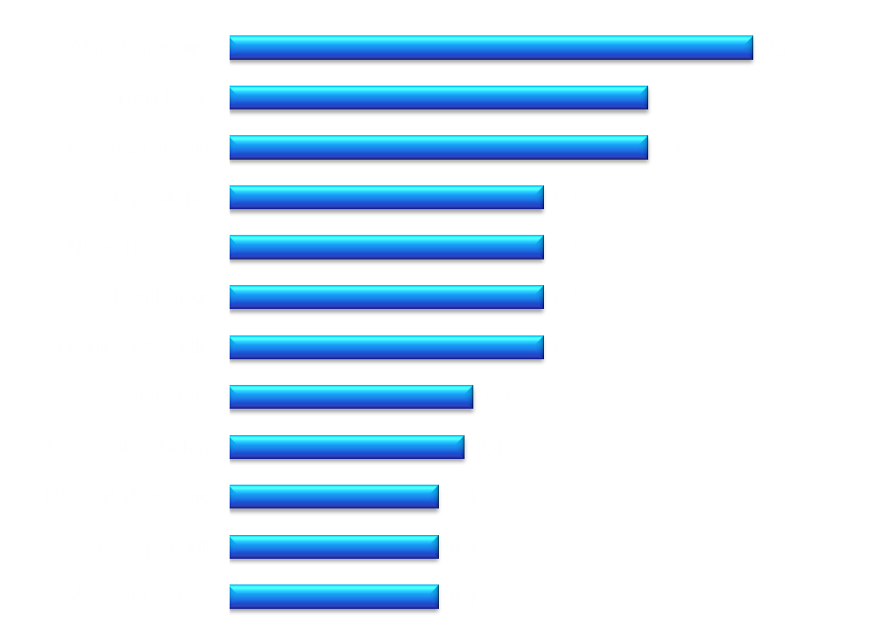
D : Identify the top directors based on their average IMDB score and
analyze their contribution to the success of movies using
percentile calculations.
Director Analysis: Influence of directors on movie ratings.
Rating shows the impact of the directors of their movies to score IMDb rating.
Akira Kurosawa, The Japanese Film Maker, Scored Highest IMDb score of the Average of all his movies and placed top of the list.
S.S. Rajamouli from India took 11th place in the list of top Directors Across the world.

Slide 49

E. Budget Analysis
Avatar took the 1st place among all the movies with $ 523.5 Million
Most of the movies are with Low and Medium budget and got Low and Medium Gross
Risk is high as the budget is getting high

Slide 50
Results
❑ Conclusions and recommendations
Most profitable movies are in the range of $100million to $300million, the company can keep their budget
between this range to minimize the risk of loss.
Shawshank Redemption followed by The Godfather and The Dark Knight are the highest IMDB rated movies
around the world, the company can take inspiration from plot of these movies.
Sergio Leone, Christopher Nolan and Hayao Miyazaki are the top 3 directors with highest mean IMDB rating
movies in the world, the company can work in collaboration with these directors.
Biography, History and War are the top 3 genres with highest mean IMDB rating movies in the world, the
company can choose genre for their next movies from these.
Leonardo DiCaprio is the most favourite actor among the critics as well as the audience around the world, the
company can cast him or can add a cameo role in the movie to create hype among the fans for the movie.

Slide 51
6. Bank Loan Case Study
Project Description
Description
Using Exploratory Data Analysis (EDA) to analyze patterns in the data and ensure that capable applicants are not rejected. And finding the relation with one another dimensions in the data and how it is influencing the results. And how imbalance dataset effect the model building.
My work
Here My work Includes Cleaning the data, finding the outliers. Finding the correlation of each features. and performing univariate bivariate analysis.

Slide 52
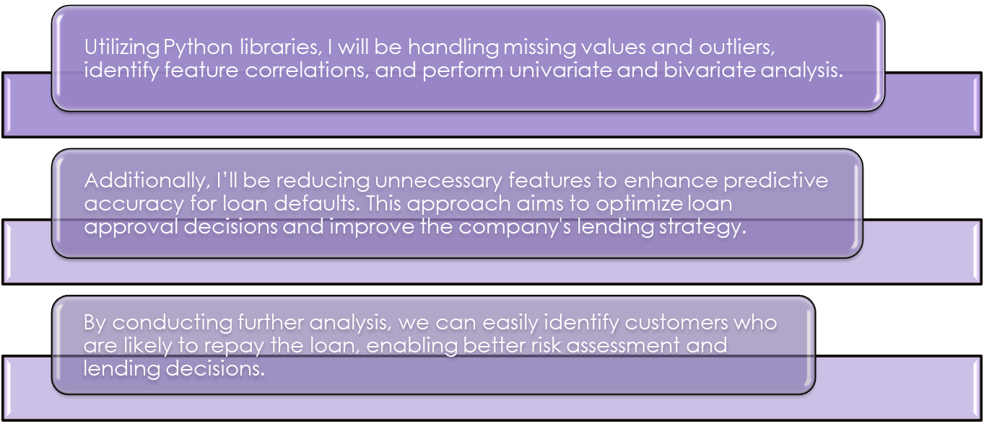
Approach

Slide 53
Tech stack used
Python
Google Colab
Pandas
Matplotlib
MS Office
Excel Pivot tables
Excel Visualisation
MS PowerPoint

Slide 54
Identify Missing Data and Dealing it Appropriately
Insights
Here I have used python to Get the null values for each column (features).
Here I have separated the columns with respect to the percentage of null values it contains so that I can easily understand what is the percentage of null values present in each column.
Then I have taken the threshold value of 50 percentage, and removed the columns which contains more than 50 percentage.
Then left with few important columns And here I have filled the null values using central tendency Method.

Slide 55
Index of columns | Column Name | Missing Values Count | Percentage Missing
0 | AMT_REQ_CREDIT_BUREAU_YEAR | 264246 | 85.930585
1 | AMT_REQ_CREDIT_BUREAU_QRT | 264246 | 85.930585
2 | AMT_REQ_CREDIT_BUREAU_MON | 264246 | 85.930585
3 | AMT_REQ_CREDIT_BUREAU_WEEK | 264246 | 85.930585
4 | AMT_REQ_CREDIT_BUREAU_DAY | 264246 | 85.930585
5 | AMT_REQ_CREDIT_BUREAU_HOUR | 264246 | 85.930585
6 | NAME_TYPE_SUITE | 257704 | 83.803181
7 | AMT_GOODS_PRICE | 257550 | 83.753102
8 | AMT_ANNUITY | 257513 | 83.741069
9 | FLAG_DOCUMENT_14 | 257512 | 83.740744
10 | FLAG_DOCUMENT_8 | 257512 | 83.740744
11 | FLAG_DOCUMENT_9 | 257512 | 83.740744
12 | FLAG_DOCUMENT_10 | 257512 | 83.740744
13 | FLAG_DOCUMENT_11 | 257512 | 83.740744
14 | FLAG_DOCUMENT_12 | 257512 | 83.740744
15 | FLAG_DOCUMENT_13 | 257512 | 83.740744
16 | FLAG_DOCUMENT_19 | 257512 | 83.740744
17 | FLAG_DOCUMENT_15 | 257512 | 83.740744
18 | FLAG_DOCUMENT_16 | 257512 | 83.740744
19 | FLAG_DOCUMENT_17 | 257512 | 83.740744
20 | FLAG_DOCUMENT_18 | 257512 | 83.740744
21 | NAME_CONTRACT_TYPE | 257512 | 83.740744
22 | FLAG_DOCUMENT_20 | 257512 | 83.740744
23 | FLAG_DOCUMENT_21 | 257512 | 83.740744
24 | FLAG_DOCUMENT_7 | 257512 | 83.740744
25 | SK_ID_CURR | 257512 | 83.740744
26 | DAYS_BIRTH | 257512 | 83.740744
27 | DAYS_REGISTRATION | 257512 | 83.740744
28 | CODE_GENDER | 257512 | 83.740744
29 | FLAG_OWN_CAR | 257512 | 83.740744
30 | FLAG_OWN_REALTY | 257512 | 83.740744
31 | CNT_CHILDREN | 257512 | 83.740744
32 | AMT_INCOME_TOTAL | 257512 | 83.740744
33 | AMT_CREDIT | 257512 | 83.740744
34 | NAME_INCOME_TYPE | 257512 | 83.740744
35 | NAME_EDUCATION_TYPE | 257512 | 83.740744
36 | NAME_FAMILY_STATUS | 257512 | 83.740744
37 | NAME_HOUSING_TYPE | 257512 | 83.740744
38 | REGION_POPULATION_RELATIVE | 257512 | 83.740744
39 | DAYS_ID_PUBLISH | 257512 | 83.740744
40 | DAYS_EMPLOYED | 257512 | 83.740744
41 | YEARS_BUILD_AVG | 209212 | 68.033989
42 | YEARS_BUILD_MODE | 209212 | 68.033989
43 | EXT_SOURCE_1 | 208077 | 67.664897
44 | LIVINGAPARTMENTS_AVG | 205475 | 66.818748
45 | ELEVATORS_MODE | 205451 | 66.810943
46 | ELEVATORS_AVG | 205451 | 66.810943
47 | LIVINGAREA_AVG | 205042 | 66.67794
48 | BASEMENTAREA_AVG | 203947 | 66.321855
49 | BASEMENTAREA_MODE | 203947 | 66.321855
50 | FLOORSMAX_MODE | 200979 | 65.356686
51 | FLOORSMIN_AVG | 184638 | 60.04273
52 | FLAG_EMAIL | 179905 | 58.503598
53 | REG_REGION_NOT_WORK_REGION | 178800 | 58.144262
54 | YEARS_BEGINEXPLUATATION_MODE | 177263 | 57.644442
55 | YEARS_BEGINEXPLUATATION_AVG | 177263 | 57.644442
56 | HOUR_APPR_PROCESS_START | 175973 | 57.224945
57 | REGION_RATING_CLIENT_W_CITY | 174748 | 56.826585
58 | NONLIVINGAPARTMENTS_AVG | 171954 | 55.918
61 | ENTRANCES_AVG | 167305 | 54.406184
62 | ENTRANCES_MODE | 167305 | 54.406184
63 | LIVINGAPARTMENTS_MODE | 165108 | 53.691738
64 | COMMONAREA_MODE | 164173 | 53.387684
65 | COMMONAREA_AVG | 164173 | 53.387684
66 | FLOORSMIN_MODE | 163116 | 53.043956
67 | NONLIVINGAREA_AVG | 157205 | 51.121748
68 | FLOORSMAX_AVG | 155551 | 50.583882
69 | LANDAREA_AVG | 155334 | 50.513315
70 | LANDAREA_MODE | 154004 | 50.08081
71 | APARTMENTS_MODE | 153530 | 49.926669
72 | APARTMENTS_AVG | 153530 | 49.926669
73 | OCCUPATION_TYPE | 152894 | 49.719847
74 | WEEKDAY_APPR_PROCESS_START | 152869 | 49.711718
75 | REG_CITY_NOT_WORK_CITY | 150744 | 49.020685
76 | FLAG_WORK_PHONE | 150744 | 49.020685
77 | LIVINGAREA_MODE | 147194 | 47.866255
78 | LIVE_REGION_NOT_WORK_REGION | 142110 | 46.212981
79 | EXT_SOURCE_3 | 139577 | 45.389271
80 | EXT_SOURCE_2 | 137366 | 44.670272
81 | FLAG_EMP_PHONE | 130676 | 42.49474
82 | REG_CITY_NOT_LIVE_CITY | 130676 | 42.49474
83 | CNT_FAM_MEMBERS | 129634 | 42.15589
84 | REG_REGION_NOT_LIVE_REGION | 129213 | 42.018985
85 | REGION_RATING_CLIENT | 128145 | 41.67168
86 | FLAG_CONT_MOBILE | 125613 | 40.848295
87 | LIVE_CITY_NOT_WORK_CITY | 125613 | 40.848295
88 | FLAG_MOBIL | 51021 | 16.591602
89 | NONLIVINGAPARTMENTS_MODE | 35567 | 11.56609
90 | COMMONAREA_MEDI | 34960 | 11.368699
91 | DAYS_LAST_PHONE_CHANGE | 34786 | 11.312116
92 | FLAG_DOCUMENT_4 | 34785 | 11.31179
93 | FLAG_DOCUMENT_6 | 34785 | 11.31179
94 | FLAG_DOCUMENT_5 | 34785 | 11.31179
95 | FLAG_DOCUMENT_2 | 34785 | 11.31179
96 | FLAG_DOCUMENT_3 | 34785 | 11.31179
97 | NONLIVINGAPARTMENTS_MEDI | 34714 | 11.288702
98 | LIVINGAPARTMENTS_MEDI | 34226 | 11.130008
99 | FONDKAPREMONT_MODE | 34191 | 11.118627
100 | FLOORSMIN_MEDI | 33894 | 11.022045
101 | OWN_CAR_AGE | 33484 | 10.888716
102 | YEARS_BUILD_MEDI | 33239 | 10.809044
103 | BASEMENTAREA_MEDI | 30052 | 9.772659
104 | LANDAREA_MEDI | 29721 | 9.66502
105 | NONLIVINGAREA_MODE | 28425 | 9.243572
106 | NONLIVINGAREA_MEDI | 27572 | 8.966183
107 | ELEVATORS_MEDI | 26651 | 8.666682
108 | APARTMENTS_MEDI | 26238 | 8.532378
109 | WALLSMATERIAL_MODE | 25459 | 8.279053
110 | ENTRANCES_MEDI | 25195 | 8.193203
111 | LIVINGAREA_MEDI | 25137 | 8.174342
112 | HOUSETYPE_MODE | 25075 | 8.15418
113 | FLOORSMAX_MEDI | 24875 | 8.089142
114 | YEARS_BEGINEXPLUATATION_MEDI | 24394 | 7.932724
115 | TOTALAREA_MODE | 24148 | 7.852727
116 | EMERGENCYSTATE_MODE | 23698 | 7.706391
117 | DEF_60_CNT_SOCIAL_CIRCLE | 168 | 0.054632
118 | OBS_60_CNT_SOCIAL_CIRCLE | 168 | 0.054632
119 | DEF_30_CNT_SOCIAL_CIRCLE | 168 | 0.054632
120 | OBS_30_CNT_SOCIAL_CIRCLE | 168 | 0.054632

Slide 56
Null values which contains
more then 50%

Slide 57
null Values with less than 50%
Filling null values with central tendency
Here: X is the Independent variables
Used mode() functionality for string/ object type data
Used median() functionality for numerical/(int or float) data
As I have not handled the outliers yet so I am going with median() function.
for i in X.columns:
if X[i].dtypes == 'object':
X[i] = X[i].fillna(X[i].mode()[0])
else:
X[i] = X[i].fillna(X[i].median())

Slide 58
Null values removing w.r.t Target variable
loanapp = pd.concat([X,y], axis = 1)
loanpre = loanapp.dropna(subset=['TARGET'], axis = 0)
Then again, I have concatenated the target variable with the independent variables
Then I have removed the null values with respect to Target variables by rows.

Slide 59
B. Identify Outliers in the Dataset.
cols = ['OWN_CAR_AGE’, 'APARTMENTS_AVG’, 'APARTMENTS_MODE','APARTMENTS_MEDI','BASEMENTAREA_MEDI','ENTRANCES_MEDI','FLOORSMAX_MEDI','LANDAREA_MEDI','LIVINGAPARTMENTS_MEDI','LIVINGAREA_MEDI','TOTALAREA_MODE','DAYS_LAST_PHONE_CHANGE’,]
Above are the numerical, continuous data type columns which has outliers, Apart from these, either it could be a categorical columns or an object data type columns.
Outliers are found after handling the missing values.

Slide 60
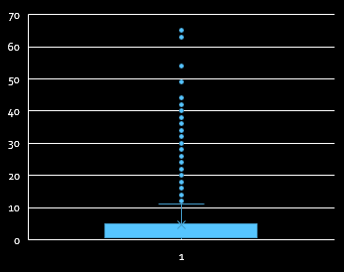
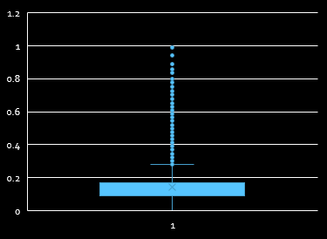
Data Cleaning
Entrance medi
Own car age
apartments mode
Stats Des | values
Mean | 0.0368
Std | 0.0686
Min | 0.0
25% | 0.0
50% | 0.0
75% | 0.631
max | 1
Apartment medi
apartments avg
Stats Des | values
Mean | 0.067
Std | 0.091
Min | 0.0
25% | 0.0187
50% | 0.0187
75% | 0.0843
max | 1
floors max medi

Slide 61
C. Analyse Data Imbalance
In the TARGET variable the output column there is clear mention about the clients who are having difficulty in paying payments with mentioning as 1 and 0 for All other cases.
Here I have to identify the ratio or the percentage spread of zero and one in TARGET variable.
Imbalance data always leads to overfitting the model and eventually gives less accuracy.

Slide 62
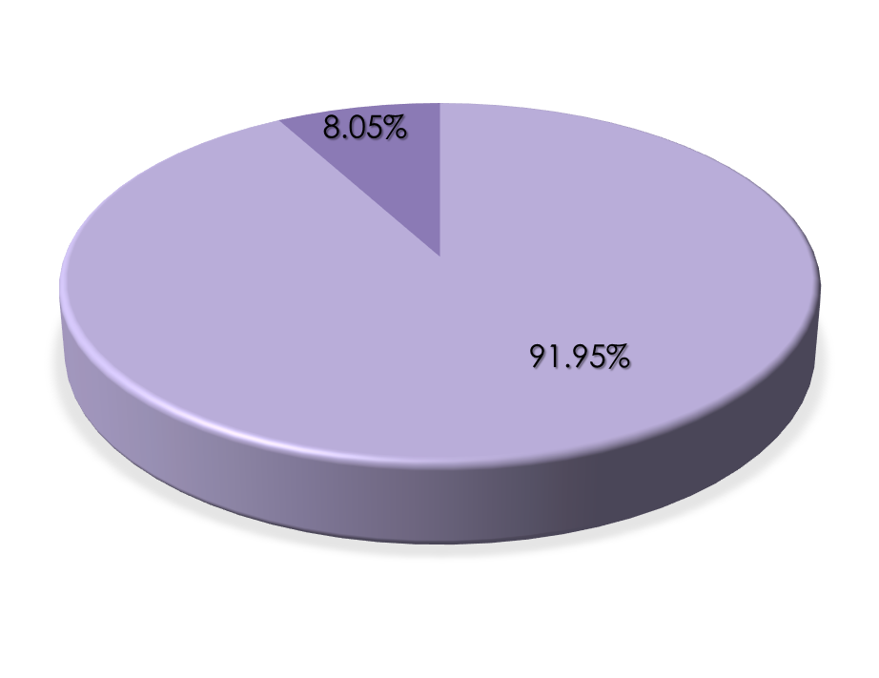
DATA IMBALENCE
TARGET: output column contains
8.05 percentage of Defaulters data and
91.95 percentage of other clints data
TARGET: output column contains
4026 number of Defaulters data and
45973 number of other clints data

Slide 63
D. Perform Univariate, Segmented Univariate, and Bivariate Analysis
Univariate: This univariate analysis is used to understand the spread distribution of the values of each individual variable.
I’ve used histogram plots to display the distribution of each continuous variable and for segments, Histograms group data into bins, and the bin height shows the count of data points within a specific range. This aids in identifying value concentrations and distributions across the data range, providing insights into the distribution's shape and value patterns.
For categorical variables, I've used count plots. These plots display the frequency of each category, giving an understanding of how often each category appears in the data.

Slide 64
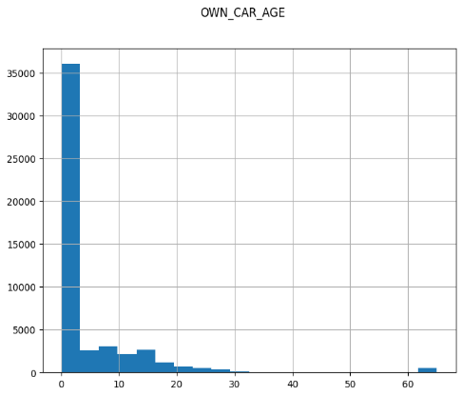
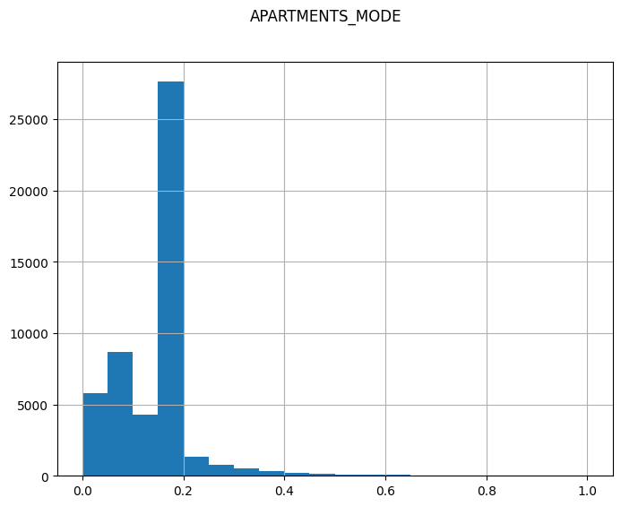
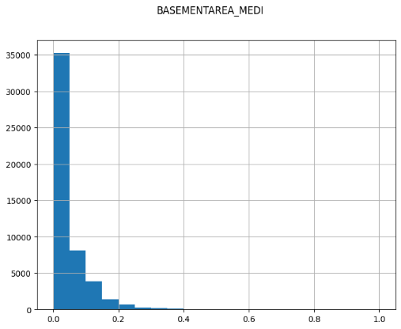
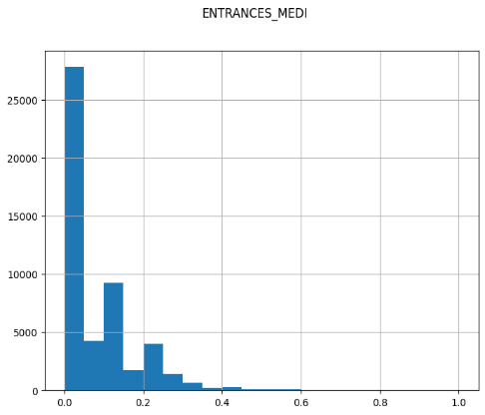
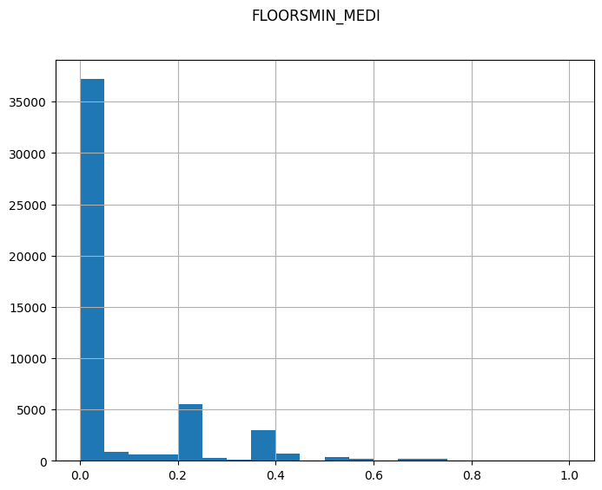

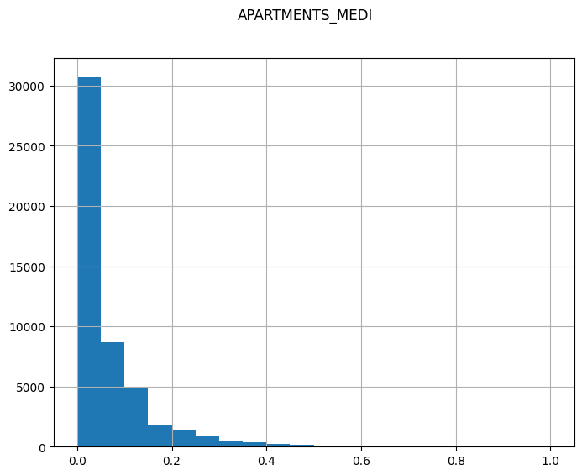
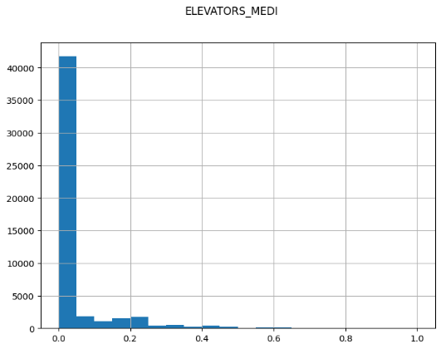
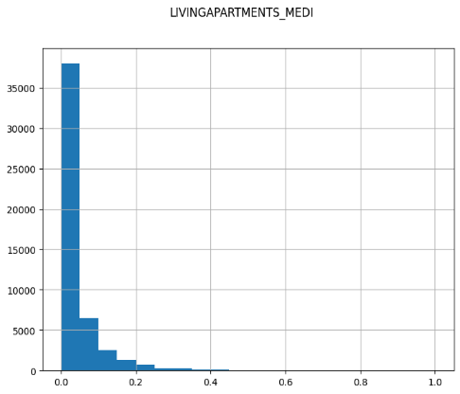
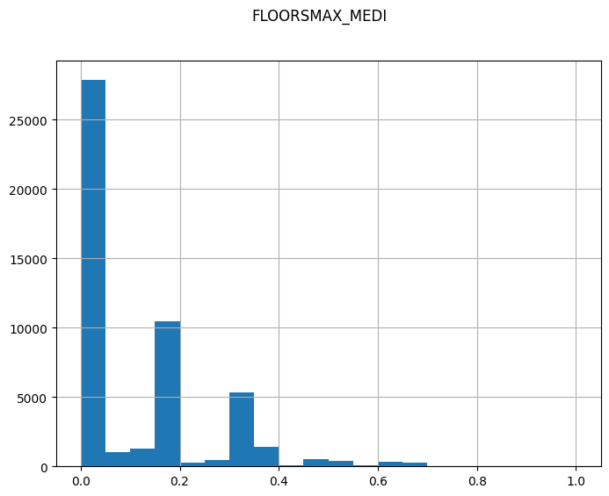
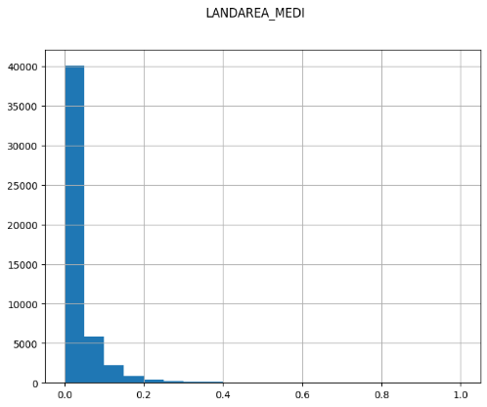
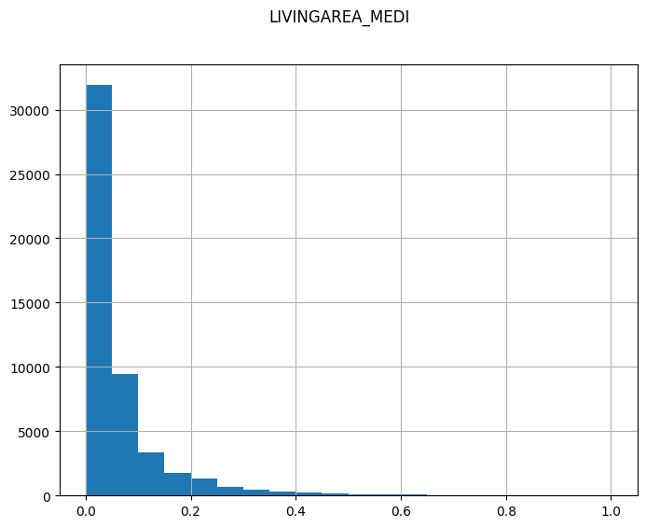
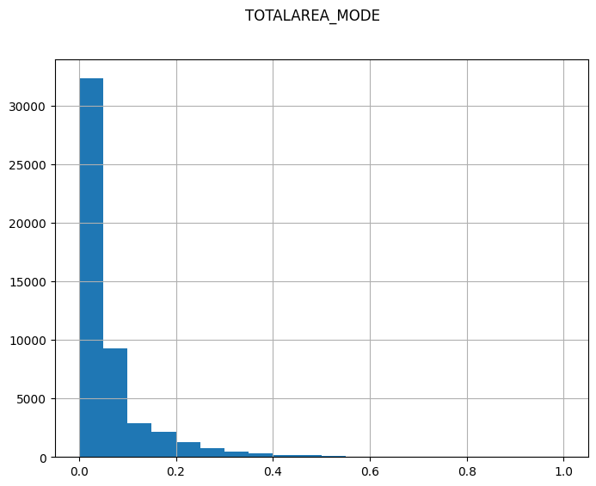
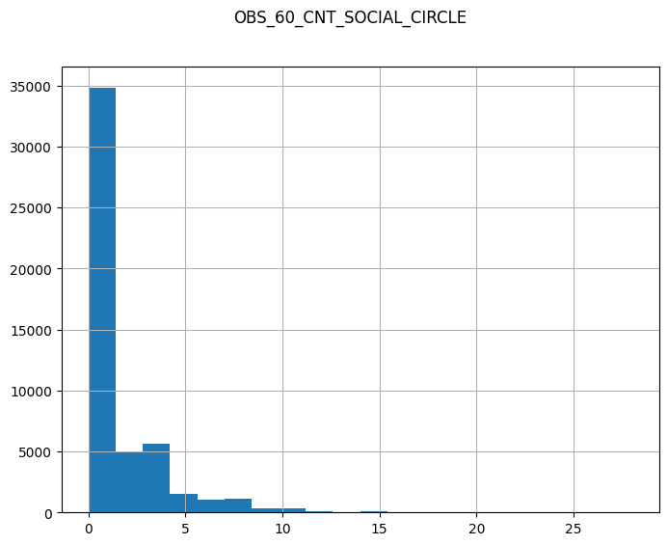
Univariate: continuous

Slide 65
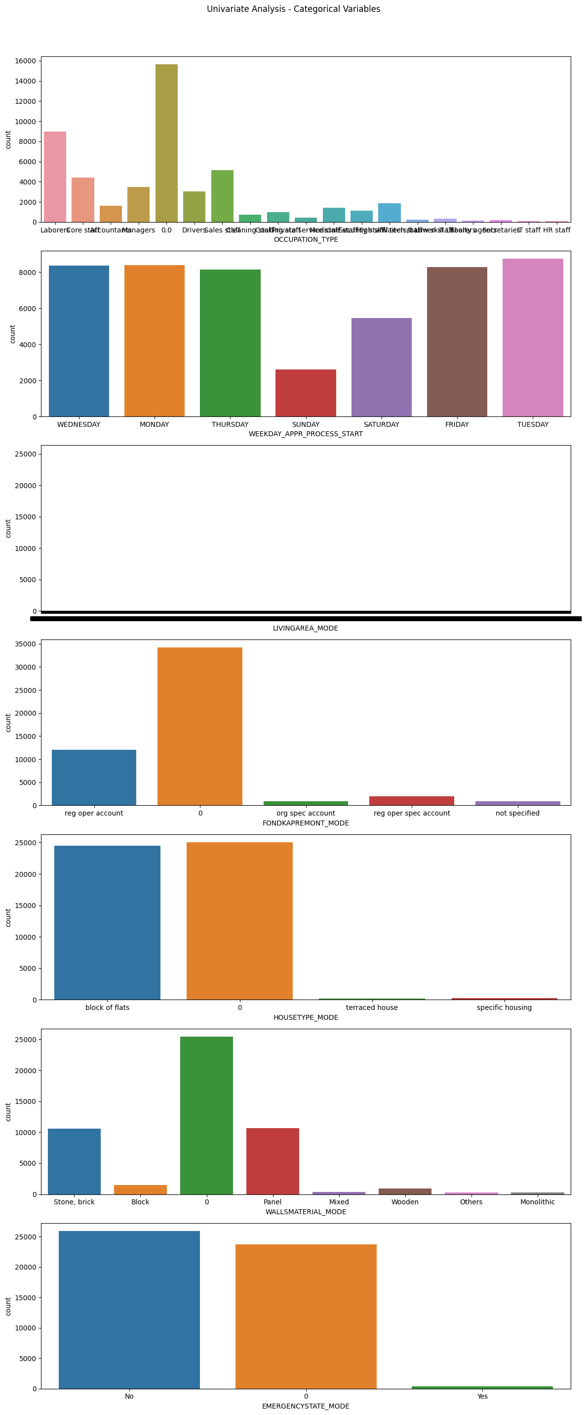
Univariate: categorical

Slide 66
Results
❑ Conclusions and recommendations
Clients with High Region rating, not provided document 3, low days employment, days ID
published, days registration should be denied loans as they are at high risk of default.
Clients with low annuity amount, unemployed, lower secondary or incomplete education type,
single or civil married, belongs to age group 20-30 should be lend at high interest rate or lower
amount as they are also at moderate risk of default.
Clients with very high income, annuity, credit amount, having higher education, owns car, house or
flat are good customers for the bank. The bank should make strategies to attract them and make
loan process easier for them.

Slide 67
7. Impact of Car Features
Project Description
The automotive industry has been rapidly evolving over the past few decades, with a growing focus on fuel efficiency, environmental sustainability, and technological innovation.
With increasing competition among manufacturers and a changing consumer landscape, it has become more important than ever to understand the factors that drive consumer demand for cars.
In recent years, there has been a growing trend towards electric and hybrid vehicles and increased interest in alternative fuel sources such as hydrogen and natural gas.
At the same time, traditional gasoline-powered cars remain dominant in the market, with varying fuel types and grades available to consumers.
This Project is about analyzing patterns in the various Car features to understand the factors that drive consumer demands for Cars.
These insights will be helpful for Car manufacturers, dealers and other stakeholders to determine the important factors to boost sales of Cars.

Slide 68
Approach
Downloaded and imported the dataset in Jupyter Notebook, performed data cleaning i.e. removing missing & invalid rows and handling outliers. Used Tableau a visualization tool to draw graphs and finding insights. And finally drawn conclusions from insights and made recommendations
Tech Stack Used
Python 3.9.6 — Programming language used for Data Pre- processing.
Jupyter Notebook 6.5.2 — Interactive platform to write and execute codes in various programming languages (in this case Python).
Microsoft Excel 2021 — A spreadsheet editor software used mainly
by professionals to enter data in table format, perform
computations, plot graphs etc.
4. Tableau Public 2021.2 — A visualization tool to represent
data in graphs and plots. Mainly used to create Dashboard

Slide 69
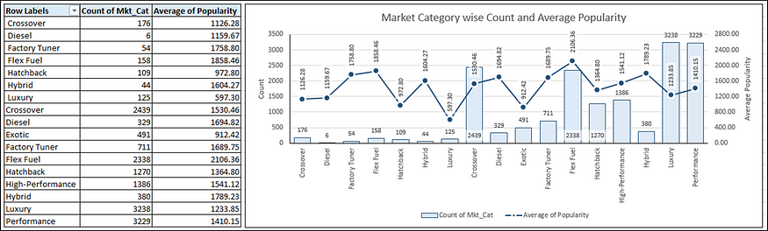
Insights
1. A pivot table that shows the number of car models in each market category and their corresponding popularity scores.

Slide 70
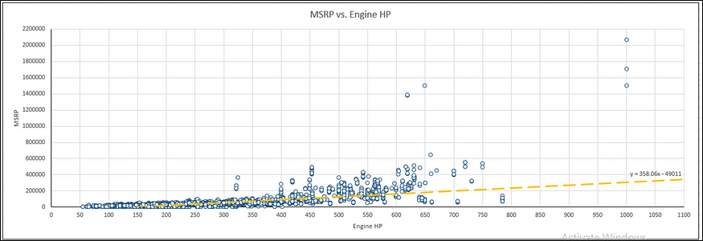
2. A scatter chart that plots engine power on the x-axis and price on the y-axis. Add a trendline to the chart to visualize the relationship between these variables.

Slide 71
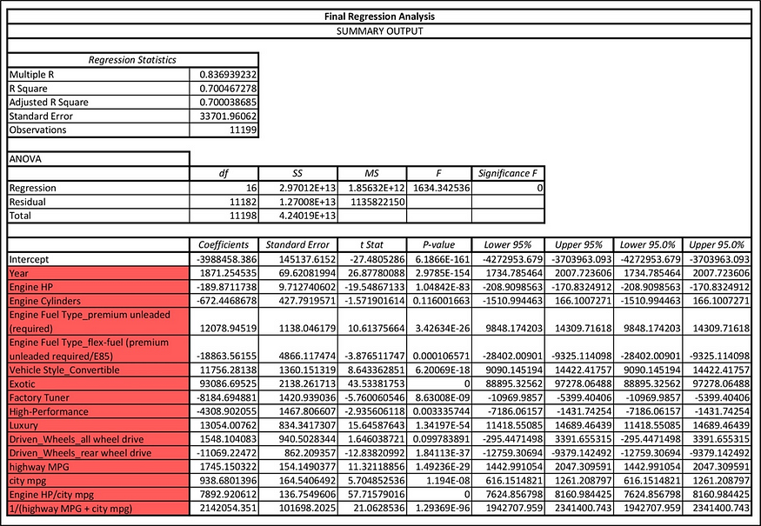
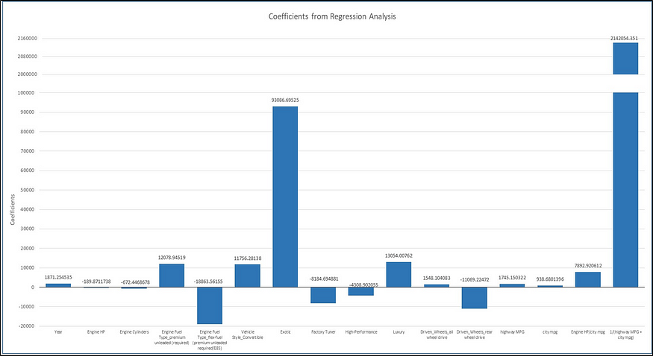
3. Use regression analysis to identify the variables that have the strongest relationship with a car’s price. Then create a bar chart that shows the coefficient values for each variable to visualize their relative importance.
Using regression analysis, we found the top columns. This also include two new columns which were Feature Engineered (Engine HP/city mpg) and (1/(highway MPG + city mpg)).
We can observe that the R-Squared score is 0.7 which can be counted as a good score.

Slide 72
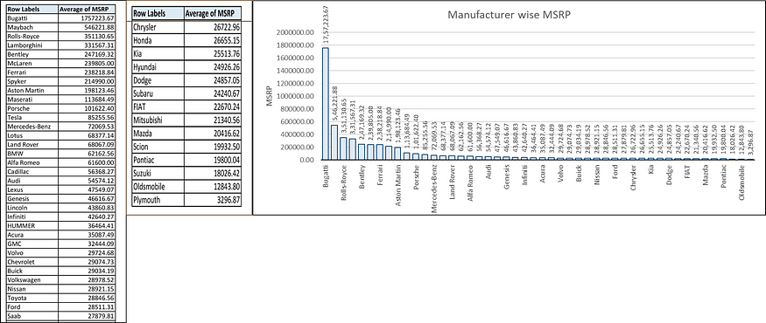
4. A pivot table that shows the average price of cars for each manufacturer.
5. A bar chart or a horizontal stacked bar chart that visualizes the relationship between manufacturer and average price.

Slide 73
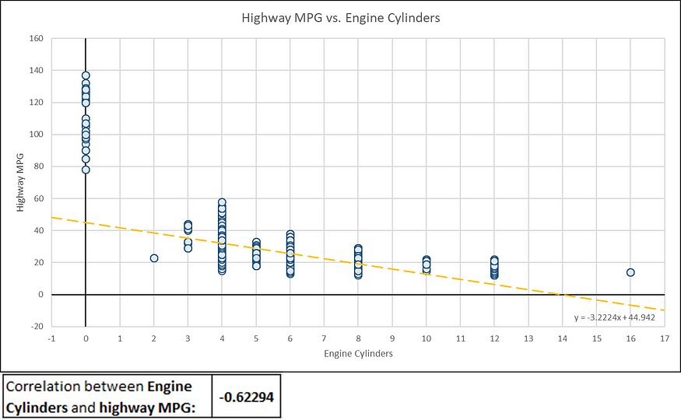
6. A scatter plot with the number of cylinders on the x-axis and highway MPG on the y-axis. Then create a trendline on the scatter plot to visually estimate the slope of the relationship and assess its significance.
7. Calculate the correlation coefficient between the number of cylinders and highway MPG to quantify the strength and direction of the relationship.

Slide 74

Dashboard: Analyse the impact of car feature

Slide 75
Results
❑ Conclusions and recommendations :
Cars with 200 HP engine or below are priced below $50k, 500-600 HP cars are around $100k and can go above also. Company should optimize price accordingly
Engine power and cylinder are most important feature in determining car’s price
Cars with automated_manual and automatic transmission type are high priced
There is a trade off between engine power and efficiency, more HP engine results in lower efficiency and high price
Hatchback, Flex Fuel & Diesel and crossover market category is in high demand among people
Trend of fuel efficient 4dr Hatchback and Sedan has grown over the years

Slide 76

8. ABC Call Volume Trend Analysis
The ABC Call Volume Trend Analysis project aims to analyze and interpret trends in the call volume data of the ABC company. As a data analyst, your primary objective is to provide actionable insights and recommendations to optimize call center operations and improve customer service.
Key Project Components
Data Collection
Data Cleaning and Preprocessing
Exploratory Data Analysis (EDA)
Time Series Analysis
Predictive Modelling
Root Cause Analysis
Performance Metrics
Recommendations
Visualization and Reporting
Implementation Support

Slide 77
Approach
We had received a dataset containing information about the Incoming Calls from Customers like call duration, phone number, call attended or not etc.
We first tried to understand the whole dataset.
Then we performed Data Pre-Processing where we checked and did necessary changes for missing data, error in data, outliers in data and duplicates in data.
Then we directly started performing EDA as per the queries we had. We also plotted some graphs for better understanding. Then we drew conclusions and insights based on the filtered data and the plots.
Now, since we got all the insights required, we will make a detailed report about it.

Slide 78



Tech-Stack Used
Python – Programming language used for Data Pre-processing.
Jupyter Notebook – Interactive platform to write and execute codes in various programming languages (in this case Python).
Microsoft Excel – A spreadsheet editor software used mainly by professionals to enter data in table format, perform computations, plot graphs etc.

Slide 79

Insights: Dataset Information

Slide 80


Insights 1. What is the average duration of calls for each time bucket?
The overall Average Call Duration is 196.963 seconds.
We can observe that the Average Call Duration first peaks in the morning hours before dropping to below average value during the lunch hours and then again increasing to above average value.

Slide 81


Insights
2. Can you create a chart or graph that shows the number of calls received in each time bucket?
We can observe that the number of received calls received first increases with time before dropping down.
We can also observe that the number of abandoned calls are very high in the morning hours and as the day progresses, the number of abandoned calls reduces.

Slide 82


Insights
3. What is the minimum number of agents required in each time bucket to reduce the abandon rate to 10%.
We can observe that to maintain a maximum of 10% abandon rate, we need to increase the availability of agents in the morning hours by a large margin as in these hours, the number of incoming calls are quite high and the number of agents available currently are quite low.
During afternoon hours and during late evening hours, we need to increase the availability of agents by a slight margin to maintain a maximum of 10% abandon rate.

Slide 83


Insights
4. Propose a manpower plan for each time bucket throughout the day, keeping the maximum abandon rate at 10%.
Manpower Planning : -
Call abandon rate is around 30%

Slide 84

Insights
Minimum no. of agents required in each time bucket(from 9 am to 9 pm) to reduce the abandon rate to 10%
Actual working hour on calls with customers/users
is 4.5hrs (60% of 7.5 hours) per day
avg. call duration = 198.6
an agent can answer avg. calls per day = 4.5 * 60 * 60 / 198.6s
= 81 calls/day
Average calls an agent can answer in 1hr time bucket = 81/7.5hr
= 11 calls/hr approx.
We calculated minimum agents required in each bucket to
answer 90% call = "no_calls_recv"*0.90/11

Slide 85

Insights
Manpower plan for each time bucket throughout the day, keeping the maximum abandon rate at 10%
Night Shift Manpower Planning
Min agents required in each time bucket including night shift
avg. calls/day in night shift = 30% of avg. calls/day 9am-9pm = 1527
Cal count of calls received by distributing total calls at night to different time bucket using prob distribution.
We calculated minimum agents required in each bucket to answer 90% call = "no_calls_recv"*0.90/11

Slide 86
Result
Through this project, I was able to understand the importance of Data Analytics in Customer Experience Analysis as it provides valuable insights which helps in making Data-Driven Decisions.
In this project I was able to get insights like call abandon rates, distribution of call duration, number of calls, agents, how to create a manpower plan so as to decrease abandon calls etc. I also got experience in Data Preprocessing like Data Cleaning, handling Outliers, Feature Engineering etc. in this project. I can communicate the insights to relevant stakeholders as per the requirements using which they can make proper data-driven decisions.
This Project has also helped me in understanding the various functions of Python and Excel and its working.

Slide 87
Appendix: GitHub links for all projects
1. Data Analytics Process in everyday life ------ Git
2. Instagram User Analytics ----------------------- Git
3. Operation Metrics and Analytics--------------- Git
4. Hiring Process Analytics------------------------- Git
5. IMDB Movie Analysis----------------------------- Git
6. Bank Loan Case Study--------------------------- Git
7. Impact of Car Features--------------------------- Git
8. ABC Call Volume Trend Analysis---------------- Git

Slide 88
Linked in and GitHub Links
Linked in ------------------------------ Link
GitHub -------------------------------- Link
Gmail id ------------------------------ Gmail

Slide 89
THANK YOU

